Slide 1
College Technical Math 1
Section 11.1
Laws of Exponents

Slide 2
Laws of Exponents
Unit 7 concentrates on the algebra of polynomials. Before defining what a polynomial is and the algorithms used for completing operations on polynomials, we need to review the properties and laws of exponents.

Slide 3
Exponential Notation
The key to working with exponential expressions is identifying the base of the expression.
$3x^{2}$, the base of the exponent is $x$
$(3{x)}^{2}$, the base of the exponent is $3x$
$−5^{2}$, the base of the exponent is $5$
${(−5)}^{2}$, the base of the exponent is $−5$

Slide 4
Product Rule of Exponents
For all real numbers $"b"$ ,$"n“$ and $"m“$:
$$b^{n}∙b^{m}=b^{n+m}$$
To multiply exponential expressions with the same base, add the exponents.

Slide 5
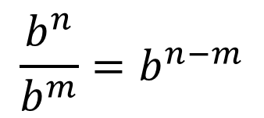
Quotient Rule of Exponents
For all real numbers $"b"$ ,$"n“$ and $"m“$:
$$\frac{b^{n}}{b^{m}}=b^{n−m}$$
To divide exponential expressions with the same base, subtract the exponents.

Slide 6
Power Rule of Exponents
For all real numbers $"b"$ ,$"n“$ and $"m“$:
$${\left(b^{n}\right)}^{m}=b^{n∙m}$$
To simplify an exponential expression raised to a power, multiply the exponents.

Slide 7
Zero Exponents
For any nonzero real number $"n"$:
$n^{0}=1$
$$5^{0}=1$$
$${\left(−3\right)}^{0}=1$$
$${10}^{0}=1$$

Slide 8
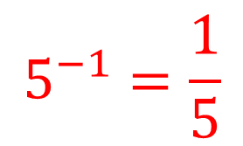
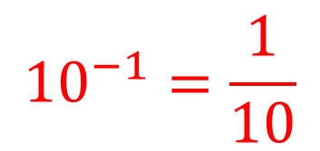
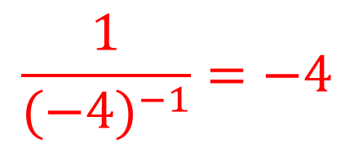
Negative Exponents
For any nonzero real number $"n"$:
$n^{−1}=\frac{1}{n} and \frac{1}{n^{−1}}=n$
$$5^{−1}=\frac{1}{5}$$
$$\frac{1}{{(−4)}^{−1}}=−4$$
$${10}^{−1}=\frac{1}{10}$$

Slide 9
Laws of Exponents
Simplify each expression. (Example)
$$a) 2x^{3}\left(5x^{8}\right)$$
$$=\left(2\right)\left(5\right)x^{3}x^{8}$$
$$=10x^{11}$$

Slide 10
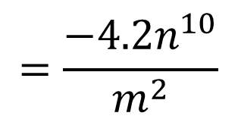
Laws of Exponents
Simplify each expression. (Example)
$$b) \left(−1.2m^{2}n^{7}\right)\left(3.5m^{−4}n^{3}\right)$$
$$=\left(−1.2\right)\left(3.5\right)m^{2}m^{−4}n^{7}n^{3}$$
$$=−4.2m^{−2}n^{10}$$
$$=\frac{−4.2n^{10}}{m^{2}}$$

Slide 11
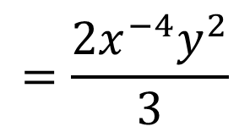
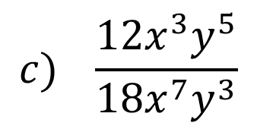
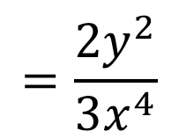
Laws of Exponents
Simplify each expression. (Example)
$$c) \frac{12x^{3}y^{5}}{18x^{7}y^{3}}$$
$$=\frac{2x^{−4}y^{2}}{3}$$
$$=\frac{2y^{2}}{3x^{4}}$$

Slide 12
Laws of Exponents
Simplify each expression. (Example)
$$d) −2x^{−3}{\left(3x^{2}y\right)}^{3}$$
$$=−2x^{−3}3^{3}{\left(x^{2}\right)}^{3}{\left(y\right)}^{3}$$
$$=−2x^{−3}\left(27\right)x^{6} y^{3}$$
$$=−2(27)x^{−3}x^{6} y^{3}$$
$$=−54x^{3} y^{3}$$

